Slide 1
WELCOME
Analee Infante
Notes:
Talk Track:
“Hi everyone! My name is ______ and I am a Transition Specialist for Paycom. I have been working with your team here at ABC Company to transition you from your current provider to Paycom. What you will find is the Paycom system is user friendly and as easy as online banking or social media. Paycom is accessible through the web or by downloading our App which I will discuss more in depth later. Today I will be talking to you about Employee Self Service with Paycom.”

Slide 2
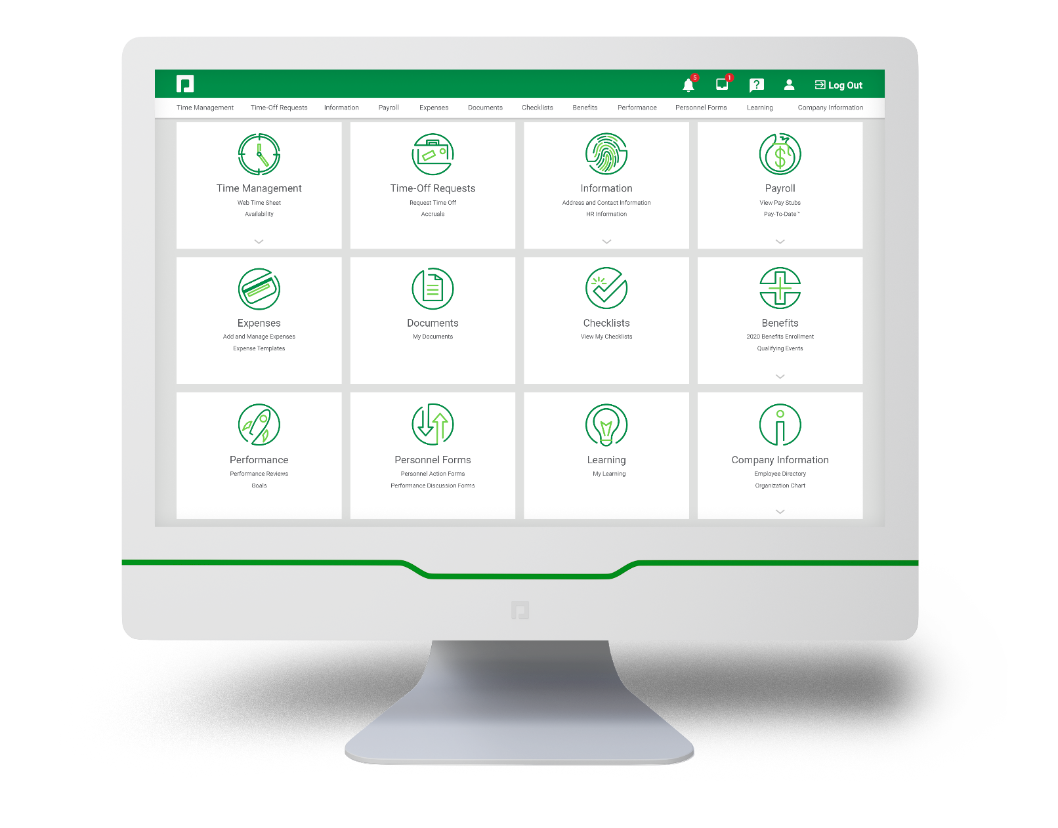
AGENDA
Important dates
Employee Self-Service overview
Verify Email & Phone
Change Username
Clocking In/Out
Data verification checklist
Direct Deposit
Tax Withhold
Questions
Notes:
“A quick run through of our agenda: we will cover some important dates to be aware of, downloading the Paycom App, an overview of Employee Self Service as well as the Data Verification Checklist. Lastly, I will go through any questions you all have.”

Slide 3
IMPORTANT DATES
Logins received: Monday, 2/24/2025
Start clocking in and out: Wednesday, 2/26/2025 – Monday, 3/10/2025
Accrual balances loaded: Early March
Checklist due date: Friday, 2/28/2025
Timecard approval due date: Monday, 3/10/2025 End of Day
Approve My Check™ due date: Wednesday, 3/12/2025 Morning
First check date: Friday, 3/14/2025
Notes:
“Some important dates to prepare for: the first is logins received. You should have received your logins on XX/XX/XX. Has everyone had a change to login? If not, we will spend the last 10-15 minutes getting you logged in.
Next, you all will begin clocking in and out through the Paycom system on XX/XX/XX. I will walk you all through how to do that today.
Then, on XX/XX/XX your accrual balances will be finalized and loaded into our system. You’ll notice when you login today they are not there because you are still processing your final payrolls with your current provider and we want to make sure we have the most up-to-date balance in our system.
Next is your Data Verification Checklist due date. You all know your information best, so please complete the checklist as it will have you verify all important information such as your address, direct deposit, emergency contact info, and more.
Next, you timecard will need to be approved by XX/XX/XX in Paycom! I will show you how to complete this on your mobile app.
Then, on XX/XX/XX you will approve your first check in Paycom. We will watch a video on approving your check in this presentation and we will discuss this in my demo as well.
On XX/XX/XX you will have your 401k deferrals live in Paycom, so you can make changes at anytime to 401k and it will flow over to Human Interest
Most importantly, your first check date with Paycom will be XX/XX/XX.
And lastly, your first Everyday transaction will be available on XX/XX/XX.

Slide 4
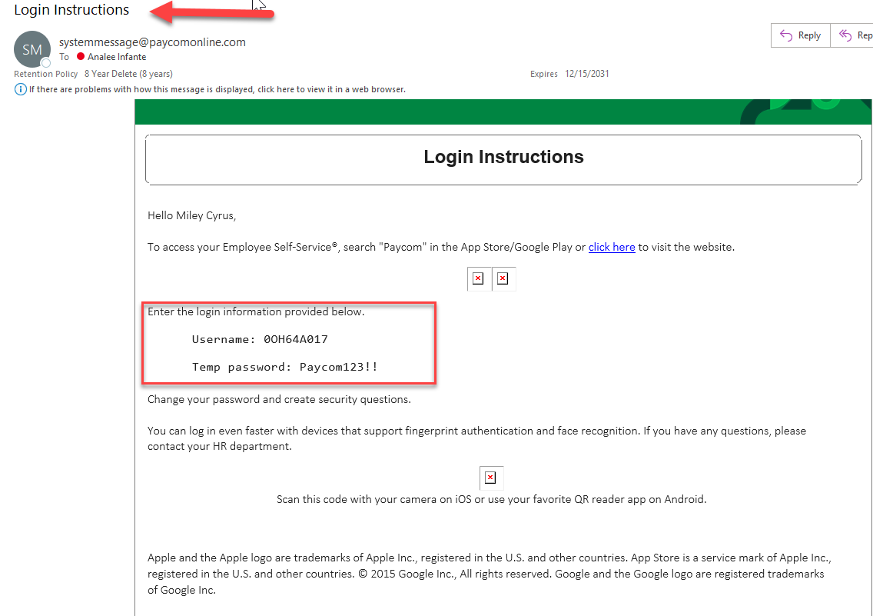
LOGIN INFORMATION

Slide 5
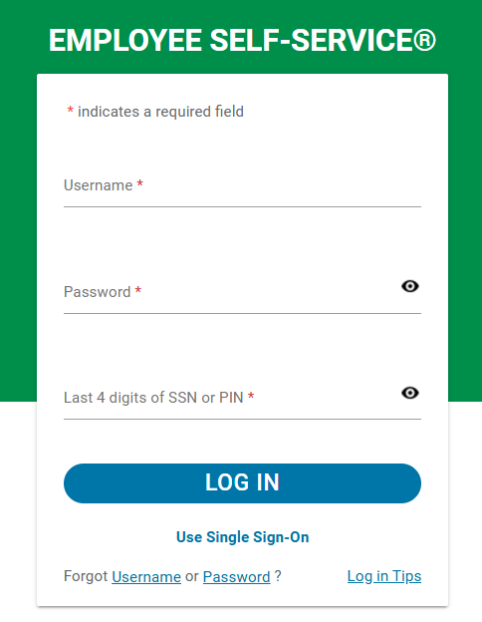
LOGGING IN TO PAYCOM
Login Instructions:
Use the information provided to you to log in. Example:
Employee: JOHN SMITH
Username: 051277896
Temp Password: bae884ef
SSN: 1234
You have the ability to change your password after you log in.
Notes:
“Once you’ve downloaded your Paycom App you can easily access your personal information. You will enter in your employee info, which includes your username, password, and last 4 of your social. Then you’ll be logged into your Employee Self Service. The first time you login you’ll be prompted to change your password and setup your security questions.”

Slide 6
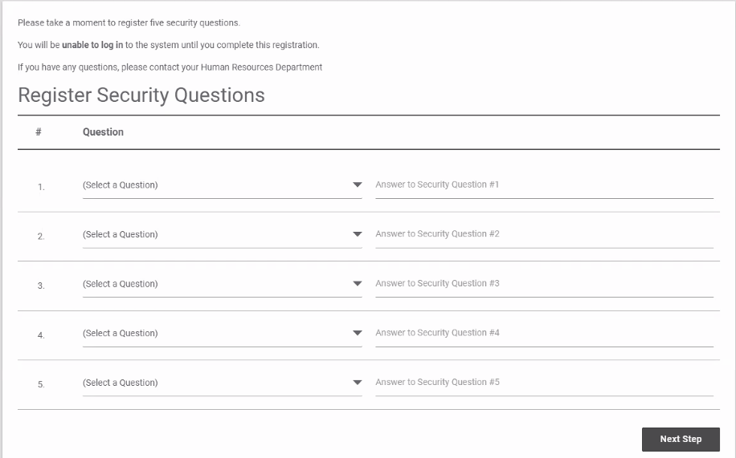
5 Security Questions

Slide 7
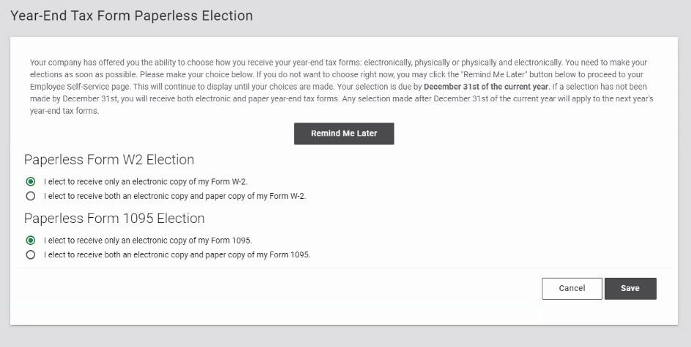
Year-End Tax Form

Slide 8
HOW DO I APPROVE MY CHECK?
Notes:
“Next we are going to watch a video on Approving Your Check in Paycom. Our Approve My Check feature will grant you visibility into your pay before your payroll has been submitted. This feature will give you the opportunity to confirm your data, whether it is your time from clocking in and out, submitting PTO, or submitting expenses. Now you can confirm that you have completing all necessary tasks before getting paid. “
“Now, let’s take a look…”

Slide 9
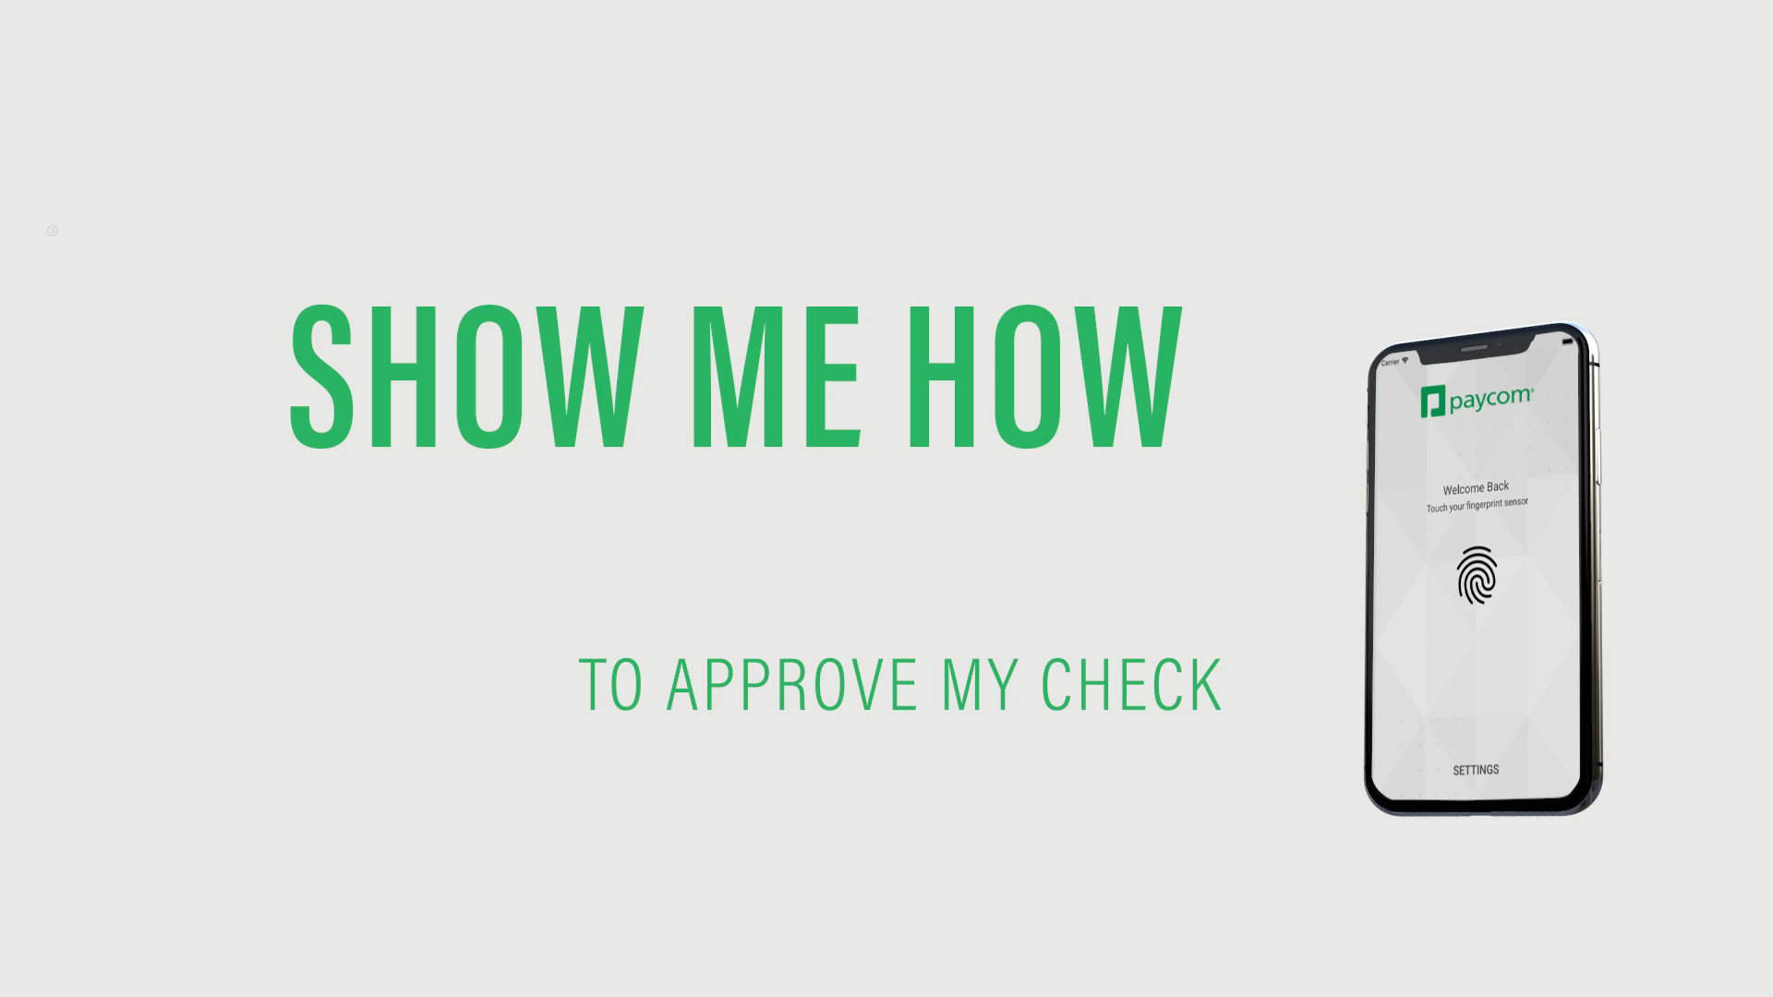

Slide 10
EMPLOYEE SELF-SERVICE OVERVIEW
Notes:
Review what is discussed on the Employee Self Service Questionnaire

Slide 11
QUESTIONS?

